Slide 1
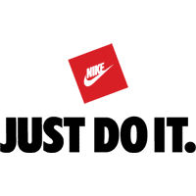
Campaign Advertising

Slide 2
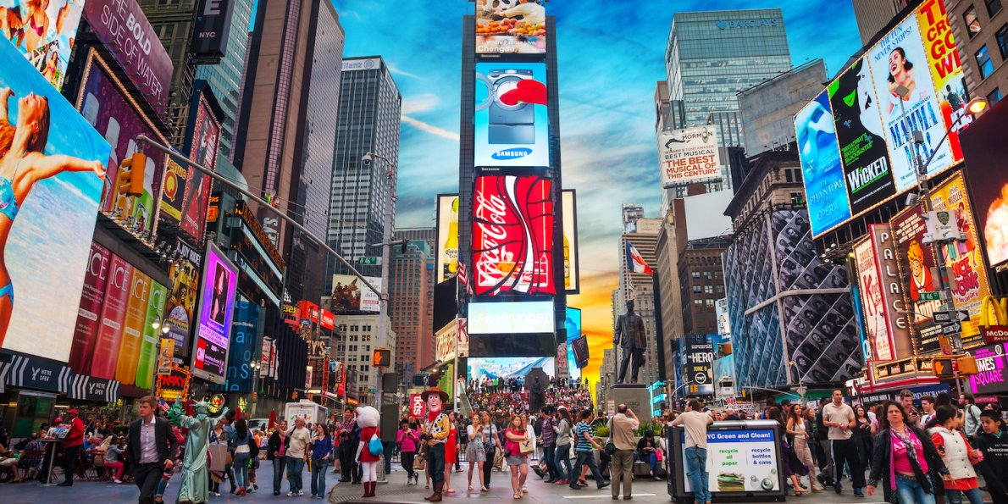
How many advertisement's can you see? What is being promoted?

Slide 3
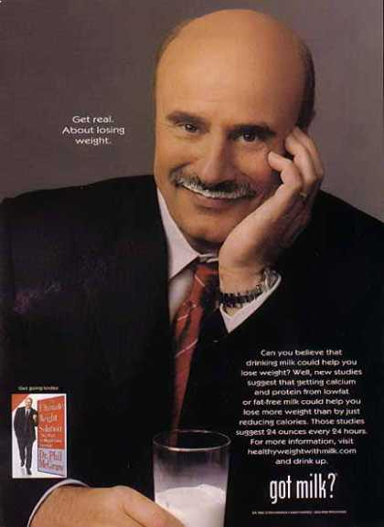
What is campaign advertising?
Campaign advertising is a
range of advertisements that
promote similar key messages
on social issues.
Campaign advertising is also
a series of advertisement
messages that share a single
idea and theme which make up integrated marketing communication.

Slide 4
Where do we see campaign advertising?
Advertising campaigns use a range of advertisements/ promotional materials, posters, magazine advertisements, TV advertisements, billboards, brochures or radio advertisements.
Campaign advertising is constructed to engage the target audience to consider key messages.

Slide 5
Print Advertising
How well advertisers can market a product on a medium such as a magazine and/or newspaper, etc relies heavily on the ability to draw a reader to the advertisement, usually through eye catching, colourful and appealing imagery.
Print advertisements usually feature the following:
An eye catching slogan
A large, full colour image/images
Product description/ marketing spiel
The product itself
Use icons and symbols to represent different levels of meaning

Slide 6
How does campaign advertising target an audience?
Certain advertising codes and conventions are manipulated to encourage a particular response from the viewer.
Persuasive techniques are used to influence responses on the viewer.
Campaign adverts identify key social issues.
Campaign adverts are targeted towards a specific audience.

Slide 7
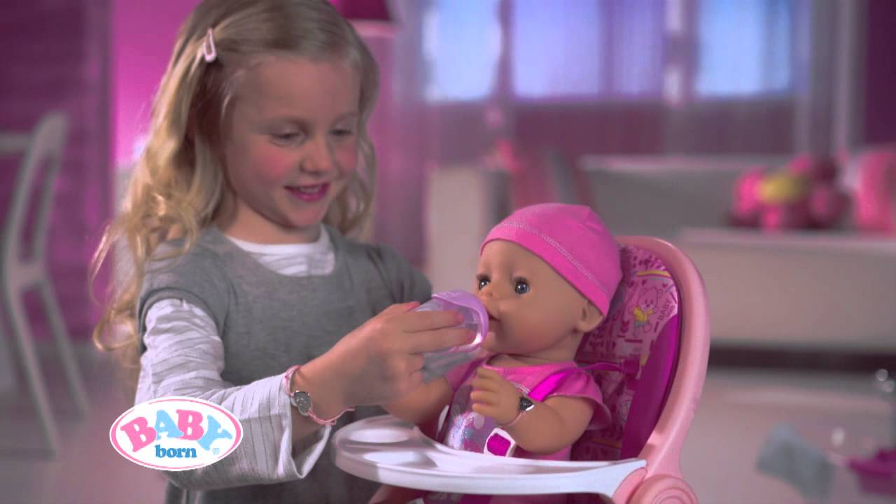
Target audiences in campaign advertising
When looking at target audience in campaign advertising there are a number of points that need to be considered:
Age
Gender
Interests
Economic background
Social issue being addressed

Slide 8
Who do you think would be the person most likely to want to buy the following products/ target audience?
Lollipops
Coca-cola
BMW
Cosmetics
Computer games
Barbie dolls
Bodyboards
Mobile phones
BMX bike
Lynx deodorant
McDonald’s hamburgers
Pokemon cards

Slide 9
Think about the slogans on the next slide. In your groups, match them with their brandname. Consider the following and write down in your groups:
The target audience for the brand/company. Who would buy these products and why? Are they exclusively for weathly people? What do buying these products say about our social status?
The message or social issue that each brand is trying to convey to the audience. (Is it to be healthier, to be prettier, to show how wealthy you are?)

Slide 10
Where are these slogans from?
"Just Do It."
"Think different.“
"Because you're worth it.“
“Yes we can.”
"There are some things money can't buy. For everything else, there's…”

Slide 11
Where are these slogans from?
"I'm Lovin' It.“
“Where the players are.”
"Maybe she's born with it. Maybe it's…”
“Slip, Slop, Slap.”

Slide 12
Where are these slogans from?
“Down down.”
“Go for 2 & 5.”
“The burgers are better at…”
“Alcohol. Think Again.”
“Every Cigarette Is Doing You Damage.”

Slide 13
"Just Do It.“ - Nike
"Think different.“- Apple Computers
"Because you're worth it.“ -L’Oreal
“Yes we can.” – Barak Obama 2008
"There are some things money can't buy. For everything else, there's…” - Mastercard
"I'm Lovin' It.“ – McDonalds
“Where the players are.” - PlayStation
"Maybe she's born with it. Maybe it's…” Mabelline
“Slip, Slop, Slap.” – Cancer Council
“Down down.” - Coles
“Go for 2 & 5.” – Healthy WA
“The burgers are better at…” – Hungry Jack’s
“Alcohol. Think Again.” - Mental Health Commission
“Every Cigarette Is Doing You Damage.” – National Tobacco Campaign (Quitline)

Slide 14
When deconstructing an advertising campaign, you need to focus on the following:
Title/Product: The product being sold.
Target Audience: Who is the intended target audience?
Visual Image: Describe the picture.
Slogan/Caption: Outline the caption.
Symbolism/colours: The symbolism of the props and what colours are used.

Slide 15
Advertising Codes and Conventions
Character Stereotypes: How typical are the characters? Is the ad appealing to one certain group?
Setting/Background: Where is it set and what is the background?
Colours: What is the symbolism behind the colours?

Slide 16
Advertising Codes and Conventions
Blurb: What is the information that accompanies the slogan?
Promise: What does this product promise the audience?

Slide 17
Advertising Codes and Conventions
Technical: How the advert is framed/what camera angle is used.
Product Info: What is the information given about the product?
Selling words (Persuasive devices): What words are used in the advert to sell the product/issue?

Slide 18
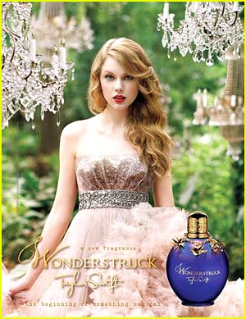
Who would be the target audience for this print advertisement?
Gender?
Age?
Interests?
Nationality?
Socio-economic status?
Values?
Where could this print advertisement appear?
What techniques of construction have been used? Eg camera shots? Camera angles?

Slide 19
Annotated techniques of construction and the effect.
Swift’s gaze is directed at the viewer. It creates a sense of connection with her
Chandeliers create the feeling of sophistication
Mid-shot to show subject, Taylor Swift. She is a well-known singer, which would appeal to teenage girls
Setting is outside with beautiful green trees in the background. Creates a natural feeling.
Beautiful, princess style dress. Creates the feeling of a fairytale.
Image of the product, so the target audience knows what it looks like to purchase
Elegant font, also creates the impression of sophistication and class
Pink dress creates the sense of something “girly”

Slide 20

Who would be the target audience for this print advertisement?
Gender?
Age?
Interests?
Nationality?
Socio-economic status?
Values?
Where could this print advertisement appear?
What techniques of construction have been used? Eg camera shots? Camera angles?

Slide 21


Symbols
In advertising, symbols can be used in logos. That way they are a very quick way for the viewer to recognise a product.
Symbols can change in different contexts,
e.g. A skull and cross bones on a ship’s flag means pirates.
A skull and cross bones on a bottle
means poison.

Slide 22




Symbolism of colour

Slide 23
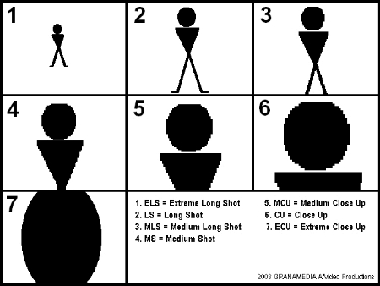
Camera Shots

Slide 24
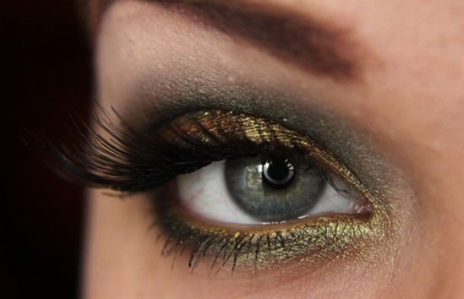
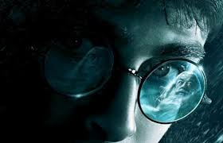
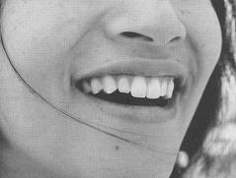

Extreme Close-up camera shots.
What do we see and what is the effect?
1
2
4
3

Slide 25
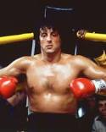
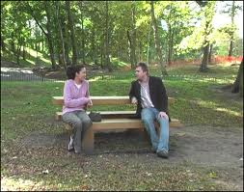
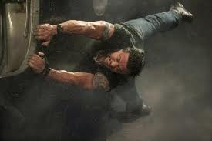
Identify the camera angle and the camera shots used in these images.
What is the effect?
1
2
3

Slide 26
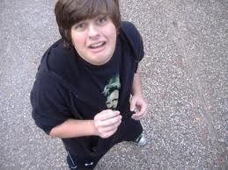
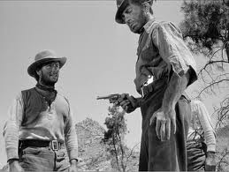
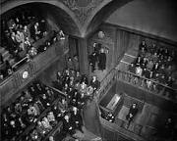
High camera angle v’s low camera angle.
What is the difference in effect?

Slide 27
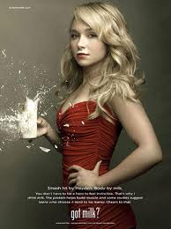
Questions:
What is the camera shot used and why?
What is the camera angle used and why?
What is being advertised?
Who is the character/subject in the advertisement and why?

Slide 28
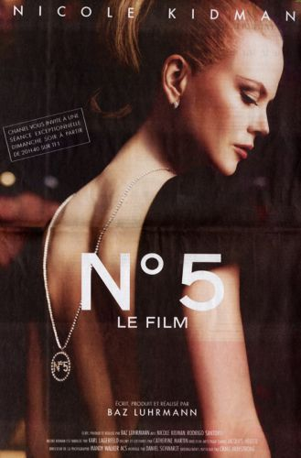
Questions:
What is the camera shot used and why?
What is the camera angle used and why?
What is being advertised?
Who is the character/subject in the advertisement and why?
Where is the subject’s gaze? What is the effect of this?
What lighting has been used? What is the effect?
What are the dominant colours and what is the effect?

Slide 29
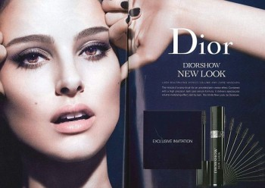
Where am I gazing?

Slide 30
GAZE
Can you write a definition explaining what “GAZE” is?

Slide 31
Why is gaze important?
Like touch, gaze is often intended and read as a sign of the relationships between people. There are two main types of gaze; towards someone and away. There are also gazes which fall somewhere in between these.
Depending on the accompanying facial expressions and situation, in our society a direct gaze can be seen as a sign of:
Confidence
Attraction
Hostility
Fear
Respect
An adverted (looking away) gaze may be interpreted, depending on the accompanying facial expressions and situation, as a sign of:
Shyness
Superiority
Disrespect
Submissiveness.

Slide 32
Like other forms of body language the meaning of a particular gaze can vary between cultures. In some cultures a direct gaze might be seen as a sign of disrespect or rudeness depending on the social positions of the people involved.
Gaze is often important in many visual texts because it can, in combination with other forms of body language and other elements of a text, suggest a relationship between the viewer of the text and the subject (the person or persons shown in the text). This is especially so when the subject is looking at the viewer. Some interpretations of gaze in modern Australian advertisements are that the person portrayed:
Is attracted to the viewer
Is equal to the viewer
Is more powerful than the viewer
Wants to be admired by the viewer
Does not care what the viewer thinks
Is unaware that the viewer is looking at him or her
Has been surprised by the viewer
Is seeking a response from the viewer.

Slide 33
So in light of this:
What is the Gaze a sign of?
What is the Gaze portraying?

Slide 34
What is the Gaze a sign of? What is the Gaze portraying? TOGETHER

Slide 35
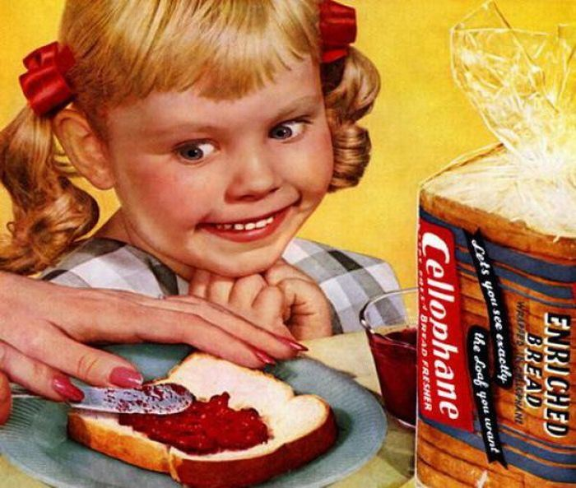
What is the Gaze a sign of? What is the Gaze portraying? In pairs

Slide 36
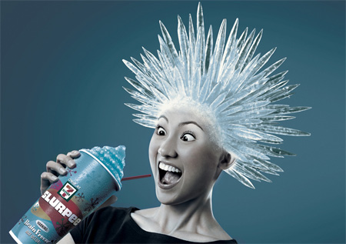
What is the Gaze a sign of? What is the Gaze portraying? On your own

Slide 37
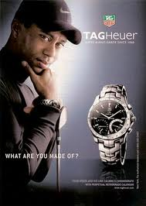
What is the Gaze a sign of? What is the Gaze portraying? On your own

Slide 38
Target Audience
Advertisers use various techniques to make their message more persuasive. One of these techniques is identifying Target Audience. A target audience is a group of people with things in common.
Eg.
Age
Gender
Interests
Income level (socio economic status)
Ethnicity/ Nationality
Values
Advertisers research what Appeals to a particular target audience. This allows them to produce advertisements which hopefully will encourage them to buy the product, donate money to a cause etc.

Slide 39
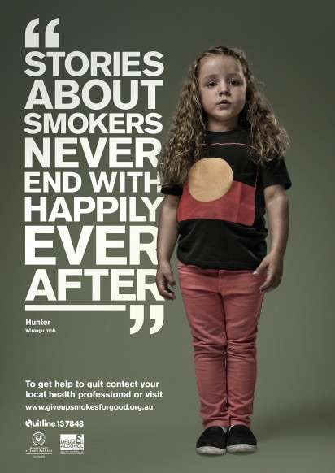

Slide 40
